Slide 1
What is Azure?
Azure is Microsoft’s cloud platform—your data center, on demand.
A Global Network of Microsoft-Managed Data Centers
Let’s you Build, Deploy, and Scale Applications, Services, and Infrastructure
Pay only for what you use--compute, storage, networking, identity, and more
Offers Thousands of Services: From VMs to AI to Kubernetes
Accessible via Portal, CLI, APIs, or Code
Resources On Demand
Azure is where you rent compute, storage, and services by the minute, instead of building your own data center
1

Slide 2
The Azure Platform – A Global, Consistent Control Plane
Azure is built on a global control plane powered by the Azure Resource Manager (ARM).
Every service, deployment, and setting flows through ARM—regardless of the tool used.
Regions house the physical infrastructure, but ARM provides consistent APIs and behavior everywhere.
You can manage Azure through:
The Azure Portal (GUI)
Azure CLI and PowerShell
SDKs (Python, .NET, etc.)
Infrastructure as Code (Bicep, Terraform)
Portal
CLI
Bicep
SDKs
Azure Resource Manager (ARM)
Azure Regions
(Physical Infrastructure)
2

Slide 3
How Azure Sees the World
Azure organizes your environment into hierarchical scopes:
Management Groups (optional)
Subscriptions (Billing Boundary)
Resource Groups (logical containers)
Resources (VMs, Vnets, Storage, etc.)
You apply RBAC, Policies, and Tags at any Scope Level
ARM Provides declarative deployment and ensures resources are deployed in the correct order.
Tools like Bicep let you describe your desired state and let Azure handle the rest.
3

Slide 4
Resources, Groups, and Scopes
Management Group
Subscription
Resource Group
Virtual Networks
Virtual Machines
Storage Accounts
And all other Resources
4

Slide 5
Azure Resource Manager (ARM)
Notes:
Lets introduces the core concepts of Azure Resource Manager (ARM)—the deployment and management layer for all Azure services.
Modern JSON-Based API (Purple Box)
ARM provides a RESTful, JSON-based API that interacts with resource providers like Microsoft.Compute, Microsoft.Network, and Microsoft.Storage.
This API is the foundation for tools like the Azure Portal, CLI, PowerShell, and SDKs.
It supports fine-grained RBAC, activity logging, and tagging, enabling enterprise-grade governance and automation.
Resource Groups and Lifecycle (Red Box)
All resources in Azure are deployed into resource groups, which act as logical containers.
Resources in a group share a common lifecycle—you can deploy, update, or delete them together.
This grouping also supports cost management, access control, and monitoring at a granular level.
Cloud Services and IaaS/PaaS (Orange Box)
Traditional Cloud Services (classic) are no longer used for IaaS deployments.
However, they are still relevant for some PaaS workloads, especially legacy applications.
Modern PaaS solutions like App Service, AKS, and Azure Functions are fully ARM-integrated.
Declarative, Idempotent Deployments (Green Box)
ARM templates are declarative: you define what you want, not how to create it.
They are idempotent, meaning repeated deployments yield the same result—ideal for CI/CD pipelines.
ARM understands resource dependencies, ensuring resources are created in the correct order.
This enables repeatable, consistent, and automated infrastructure deployments across environments.
Tip:
ARM templates can be authored in Bicep, a domain-specific language that simplifies JSON syntax while compiling down to ARM templates.
Bicep improves readability, modularity, and reusability—making it the preferred choice for infrastructure-as-code in Azure.

Slide 6











Azure Resource Manager (ARM)
Notes:
Let’s look at three additional capabilities that enhance scalability, organization, and usability.
Massive Parallelism
ARM supports parallel deployment of resources, significantly reducing provisioning time for complex environments.
When dependencies are clearly defined in templates (or Bicep), ARM can deploy multiple resources simultaneously.
This is especially powerful in CI/CD pipelines and large-scale infrastructure rollouts, where speed and efficiency are critical.
Tags for Organization and Billing
Tags are key-value pairs that help you organize, categorize, and manage Azure resources.
Common tag examples include Environment, Department, CostCenter, and Project.
Tags are not just for organization—they are also visible in Azure Cost Management and billing reports, enabling chargeback and showback models for internal cost accountability.
Azure Policy can enforce tag usage to ensure compliance across your organization.
PowerShell and Azure Portal Support
ARM is accessible through multiple interfaces:
Azure PowerShell: Ideal for scripting and automation.
Azure CLI: Lightweight and cross-platform.
Azure Portal: A modern, user-friendly interface for managing resources visually.
All these tools interact with the same ARM API, ensuring consistency and repeatability regardless of the interface used.
Tip:
Combine tags with Azure Policy and Management Groups to enforce governance at scale.
Use ARM templates or Bicep with deployment scripts to automate tagging and parallel resource creation.

Slide 7
Every ARM resource exists in one, and only one, resource group
While resource groups are created in a region they can contain resources from outside the region
Resources can be moved between resource groups
Resource Groups
Notes:
Every Azure Resource Manager (ARM) resource must belong to exactly one resource group. Whether it's a VM, database, storage account, or function app—each resource sits in one dedicated container known as a resource group.
You do assign a location when creating a resource group, but that location only determines where its metadata is stored—not the location of its resources.
In fact:
The group’s location affects where control-plane operations are routed.
You can include resources from multiple Azure regions within the same resource group.
Be aware, though: if the region hosting the resource group goes offline, you won’t be able to manage or update the group (even though the actual resources continue to run).
Lastly—and this is often overlooked—you can move resources between resource groups within the same subscription (or even across subscriptions if they share the same Microsoft Entra tenant). The resource’s physical region does not change unless you invoke a region move scenario.

Slide 8
All resources in your group should share same lifecycle.
Deploy, Update, and Delete together
Resource groups can be heterogeneous or homogeneous
Resource groups are not a boundary of access
Resource Groups
Notes:
Shared lifecycle within a group
All resources in a resource group typically share the same deployment, update, and deletion cycle. You manage them as a unit—deploy together, update together, delete together. If one resource has a different lifecycle, consider placing it in a separate group.
Heterogeneous or homogeneous composition
A resource group can be homogeneous (all resources related to a single app or environment) or heterogeneous (resources serving different apps or roles). The key is lifecycle alignment, not similarity of resource types.
Region-agnostic content
While you assign a region when creating the group, this location only stores metadata—it doesn't restrict where resources reside. You can mix resources from different Azure regions under one group .
Resource mobility
You can move resources between resource groups (and even subscriptions within the same tenant) without affecting their deployed region—although some services might briefly go offline during the move.
Access boundaries
Resource groups are not an absolute security boundary. Although you manage RBAC roles at the group level, users granted access to a resource group can see and manage all resources inside it—but they do not see resources in other groups, even in the same subscription, unless granted access .

Slide 9
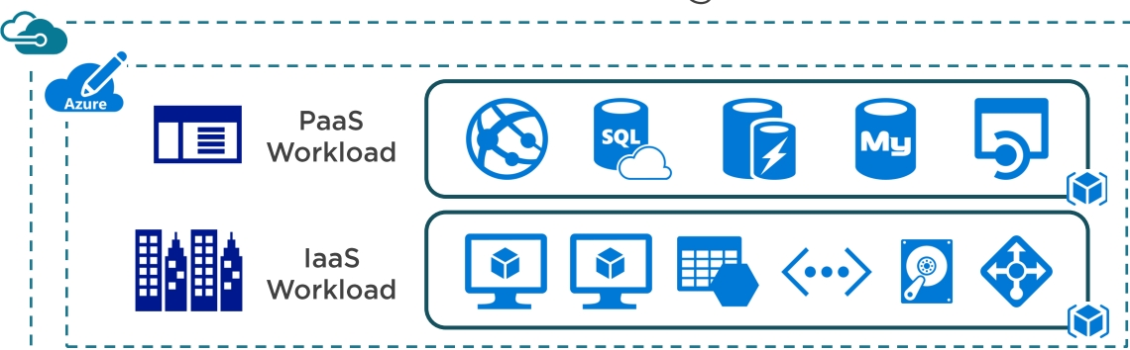


Azure resource manager architecture
9
Notes:
This slide provides a high-level overview of the Azure Resource Manager (ARM) architecture, which is the unified deployment and management layer for all Azure services.
PaaS and IaaS Workloads
At the top, we see two categories of workloads:
PaaS Workloads: These include services like App Services, Azure SQL Database, and Storage Accounts. These are fully managed by Azure and abstract away infrastructure concerns.
IaaS Workloads: These include Virtual Machines, Virtual Networks, and Load Balancers. These offer more control and are ideal for lift-and-shift or custom infrastructure scenarios.
ARM Resource Providers
Each Azure service is managed by a resource provider (e.g., Microsoft.Compute, Microsoft.Web, Microsoft.Sql).
These providers expose resource types and operations that ARM uses to provision and manage services.
For example, Microsoft.Compute/virtualMachines is the resource type for VMs.
Azure Resource Manager (ARM)
ARM is the central orchestration engine that processes all deployment requests.
It ensures that resources are deployed in the correct order, respects dependencies, and applies policies and RBAC.
ARM supports declarative templates (JSON or Bicep), idempotent deployments, and parallel execution.
ARM REST APIs
All interactions with Azure—whether through the Portal, CLI, PowerShell, or SDKs—ultimately go through the ARM REST API.
This ensures a consistent and unified management experience across tools and services.

Slide 10
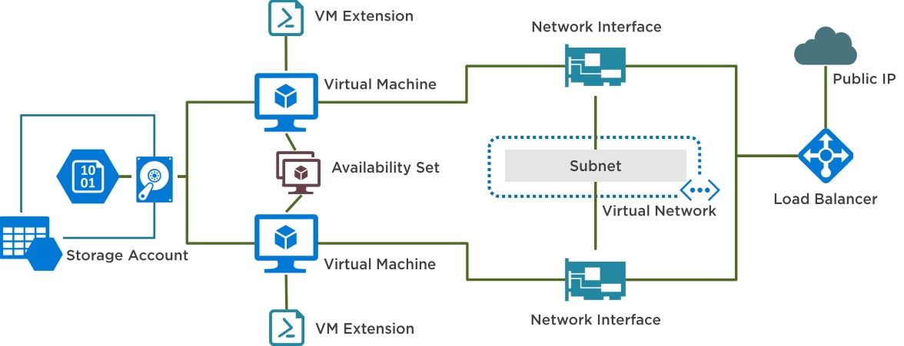
Resources and Dependencies
10
Notes:
Understanding Dependencies
In Azure, resources often depend on one another. ARM templates and Bicep files allow you to define these relationships explicitly.
This ensures that resources are created in the correct order and that configurations are applied consistently.
Key Components in the Diagram
Storage Account:
Used to store VM disks, diagnostics logs, and other data.
Must exist before VMs or extensions that rely on it are deployed.
Virtual Machine (VM):
Central compute resource.
Depends on a Network Interface, Availability Set, and optionally a VM Extension for post-deployment configuration.
VM Extension:
Scripts or agents that run on the VM after deployment.
Depends on the VM and often the Storage Account for script storage.
Availability Set:
Ensures high availability by distributing VMs across fault and update domains.
Must be created before the VMs that will be part of it.
Network Interface (NIC):
Connects the VM to the network.
Depends on a Subnet, which is part of a Virtual Network (VNet).
Subnet and Virtual Network:
Provide IP addressing and isolation.
Must be created before NICs and VMs.
Load Balancer with Public IP:
Distributes traffic across multiple VMs.
Depends on NICs and VMs being in place to configure backend pools.
Tips: Use the dependsOn property in ARM templates or implicit dependencies in Bicep to control deployment order.
For large deployments, leverage deployment scripts and nested templates to modularize and manage complexity.
Monitor deployment progress and troubleshoot issues using Azure Activity Logs and Resource Graph Explorer.

Slide 11
800 resource groups per subscription
800 resources per resource type per resource group
15 tags per resource group
Bound by subscription
Resource Group Limits
Notes:
Resource Group Limits
800 Resource Groups per Subscription:
This is the maximum number of resource groups you can create in a single Azure subscription.
While this is sufficient for most organizations, large enterprises or multi-tenant environments may need to segment workloads across multiple subscriptions.
800 Resources per Resource Type per Resource Group:
This limit applies per resource type. For example, you can have up to 800 virtual machines or 800 storage accounts in a single resource group.
This allows for high-density deployments while maintaining logical grouping.
15 Tags per Resource Group:
Each resource group can have up to 15 key-value tag pairs.
Tags are critical for cost tracking, automation, and governance.
Use Azure Policy to enforce consistent tagging across your environment.
Bound by Subscription:
Resource groups are scoped to a single subscription.
You cannot span a resource group across multiple subscriptions, but you can use Management Groups and Azure Lighthouse for cross-subscription governance and visibility.
For large-scale environments, consider using Azure Landing Zones and Infrastructure-as-Code (IaC) to manage resource group creation and enforce naming/tagging standards.
Monitor usage with Azure Resource Graph to avoid hitting soft limits and proactively plan for scale.

Slide 12
LAB: Deploy a VM via the Portal Interface
Get Started with Azure Portal!
Traditionally, we’d build resources using Bicep Templates, or IaC tools like Terrafrom
To cement our understanding of the tool, we’ll use the Portal to provision a VM.
To build a VM, we’ll also need to deploy its dependencies:
Resource Group
Virtual Network
Subnet
Network Interface (NIC)
Storage / Disks
Virtual Machine Image
Pro Tip for IaC:
When writing a Bicep or ARM Template, you must declare and manage these dependencies in the correct order--often using dependsOn explicitly or letting Azure infer it through resource references.
12

